Slide 1

Sales and Advertising Power
Customer Service Policy

Slide 2
Customer Service and Product Policies
All businesses are often governed by different policies that define the practices involved.
Some of the commonly employed policies include product policy and customer service policy.
These policies aim to present the most appropriate products and meet customer expectations (Habel et al., 2020).
Due to existing differences between businesses, the adopted policies also differ.
Notes:
Each business is often governed by various policies that define practices and actions involving product production and customer service. This is often common in both virtual and physical business stores. An excellent example of these policies is the customer service policy, which comprises a document guiding how to ensure customer success and satisfaction (Habel et al., 2020). Another example is product policy, which involves general rules concerned with defining the products availed by the business, including the types, volume, and products presented to customers for sale. Notably, different companies employ different policy types depending on factors such as the magnitude and products presented.

Slide 3
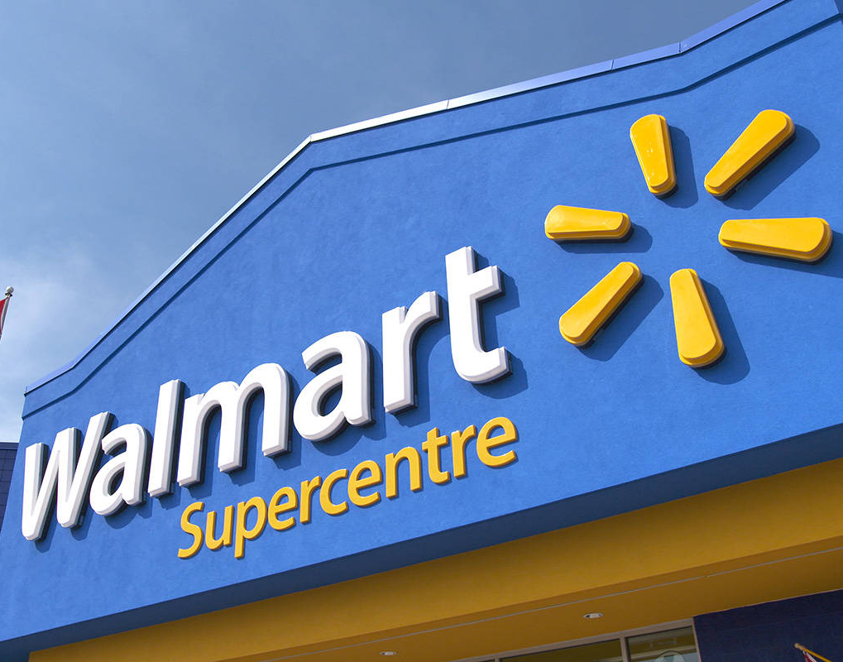
Walmart Customer Service and Product Policies
Walmart is an international retail and wholesale store.
It allows for the purchase of products both online and in physical shops.
It employs various customer service and product policies, for example, the product return policy.
The return policy in Walmart allows for a return of a product within 90 days of receipt (Hunt et al., 2018).
Notes:
The selected store is Walmart, which provides goods in retail and wholesale. Moreover, due to the company's magnitude, Walmart uses a variety of methods via which customers get access to products since it is both an online and a brick-and-mortar (BAM) store. Moreover, it also has various customer service and product policies. An excellent example is the product return policy, which forms part of customer service since it governs the ability of customers to return damaged or unwanted goods previously purchased (Hunt et al., 2018). In this case, Walmart allows for the return of products within 90 days of purchase, with the exception of products such as computers, tablets, and digital cameras, which should be returned with 15 days of receipt.

Slide 4
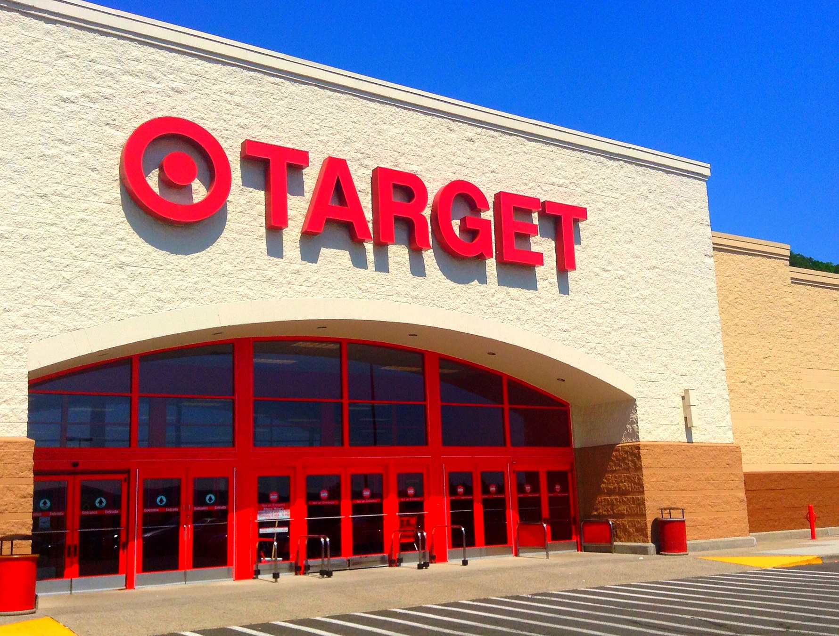
Target Customer Service and Product Policies
Target is a significant competitor to Walmart and offers retail services.
In order to meet the customers' expectations and needs, operations in the business are governed by various policies.
The return policy is one of the enacted policies.
At Target, the return of purchased products is allowed within 90 days of receipt, but with various exceptions (Matloob, 2019).
Notes:
One of the major competitors of Walmart is Target, which is also a retail store, mainly a BAM store. In order to ensure that the quality of products presented to the customers are of high quality and customers are satisfied with the services provided, various policies exist in the company. Similar to Walmart, Target has a product return policy. Moreover, the return policy also bases on the return of purchased goods within 90 days of receipt (Matloob, 2019). However, this return policy often varies depending on the type of goods under consideration. Precisely, for a target-owned-brand item, Target allows the return or exchange of the product up to a year after the receipt of the product. In addition, Target often does not allow returns on products such as video games and software products already opened.

Slide 5
Comparison of the two Policies
Positive Aspects
Both return policies are similar, but with differences depending on the type of product under consideration.
In business, one of the major factors used by customers to evaluate the aspects f any return policy is the duration allowed for the returns (Matloob, 2019).
Therefore, one of the positive aspects common to both policies is that they provide an extended return period, allowing for customers to evaluate the products.
Notes:
Both return policies of Walmart and Target are similar; however, the terms and conditions provided for each business are different, which brings about a slight difference. Based on the evaluation of the two return policies, one of the positive aspects evident is that both policies allow for the return of products within a long period of 90 days (Matloob, 2019). This is a positive aspect because one of the factors used to gauge the effectiveness of a return policy is the period allowed for the return. Therefore, in most cases, this allows for the consumer to experience the products with the opportunity to return them in case of any challenges, as outlined by the policy.

Slide 6
Comparison of the two Policies Continuation
Negative Aspects
The significant negative aspect considered is associated with the return period allocated to electronics.
Different electronics function differently and cost different amounts, which should be considered in the allocated return policy.
Although Walmart and Target have different policies governing different products, this should also be applied in electronics (Matloob, 2019).
Notes:
Although both policies have various positive aspects that make it favorable for customer service, they also have various negative aspects; for example, both offer the return of electronics within 90 days. This is perceived to be a negative aspect since electronics vary when it comes to durability and operation. In most cases, depending on the type of electronic, the return period is more extended than most products. Therefore, both businesses should consider increasing the return period of electronics based on the type. Although both have exceptions in the return policy, many are based on the type of product under consideration (Matloob, 2019). This approach should also be adopted when addressing the return policy of electronics.

Slide 7
Proposed Change
I would recommend adopting flexibility in the existing policies to respond to the changes in the economy effectively (Habel et al., 2020).
An excellent example of the changes experienced is the existence of a global pandemic affecting economic activities.
This change can be implemented by adding days to the return period and diversification of media through which customers can make the returns.
Notes:
One of the significant changes I would recommend is for the policies to be flexible. This is because, over time, the economy has been hit by various changes, adversely affecting the ability of customers to make purchases and returns. An excellent example is a global pandemic currently affecting the economy, which is covid-19. In the face of these adverse conditions, many people have inadequate finances to maintain their livelihoods. Therefore, flexibility should be evident in the adopted return policies to allow customers the time to make better financial decisions and make the returns conveniently (Habel et al., 2020). An excellent example of the desired flexibility is additional time to the return period and providing a wide range of media to make the returns.

Slide 8
References
Habel, J., Kassemeier, R., Alavi, S., Haaf, P., Schmitz, C., & Wieseke, J. (2020). When do customers perceive customer-centricity? The role of a firm's and salespeople's customer orientation. Journal of Personal Selling & Sales Management, 40(1), 25-42.
Hunt, I., Watts, A., & Bryant, S. K. (2018). Walmart’s international expansion: successes and miscalculations. Journal of Business Strategy.
Matloob, A. (2019). Study on Success and Failure Depending on Organizational Behaviour. Nolegein-Journal of Organizational Behavior and Management, 27-30.

